Slide 1
Stereo Vision with Deep Learning
Barış Bakırdöven - 29028
İpek Akkuş - 30800
Ozan Parlayan - 29283

Slide 2
Problem Definition and Motivation
What is Stereo Vision?
Why is Stereo Vision Critical?
Challenges

Slide 3
Proposed Solutions and Datasets
Solutions:
Classical Method
Hybrid Method
End-to-end Deep Learning Based Methods
HITNet and StereoNet with lightweight backbone modifications
Datasets:
Middlebury Stereo Dataset
KITTI Stereo Dataset

Slide 4
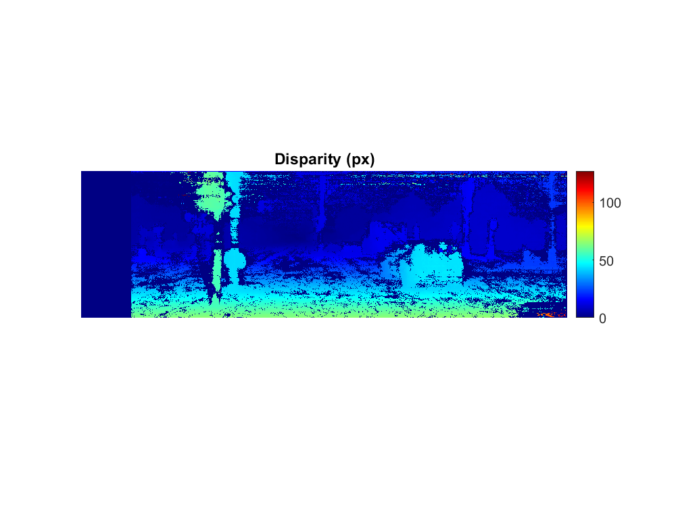
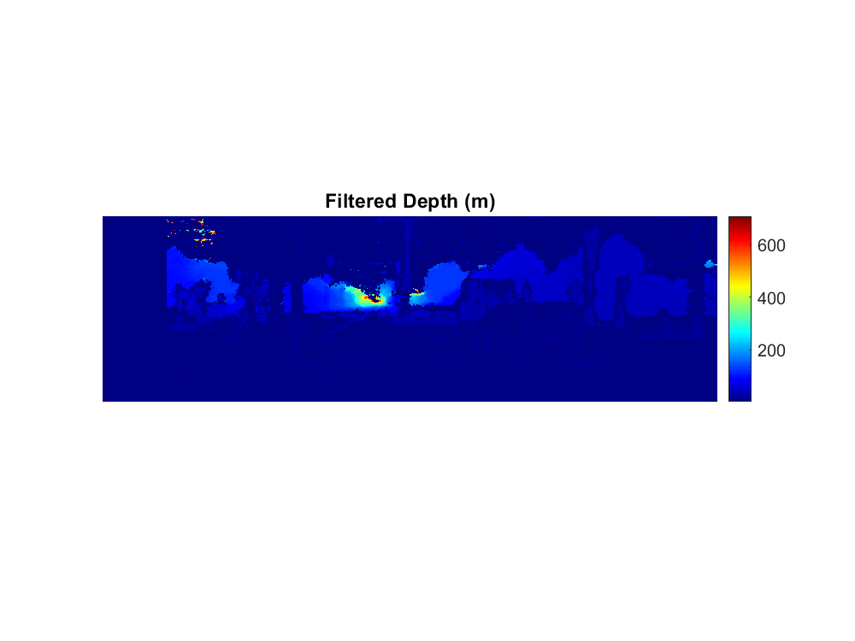
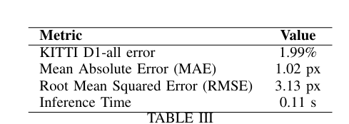
Classical Method
Camera Calibration and Rectification
Disparity Estimation with SGM
Depth Conversion
Post Processing
Evaluation on KITTI

Slide 5
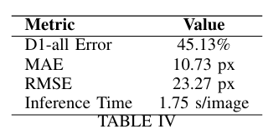
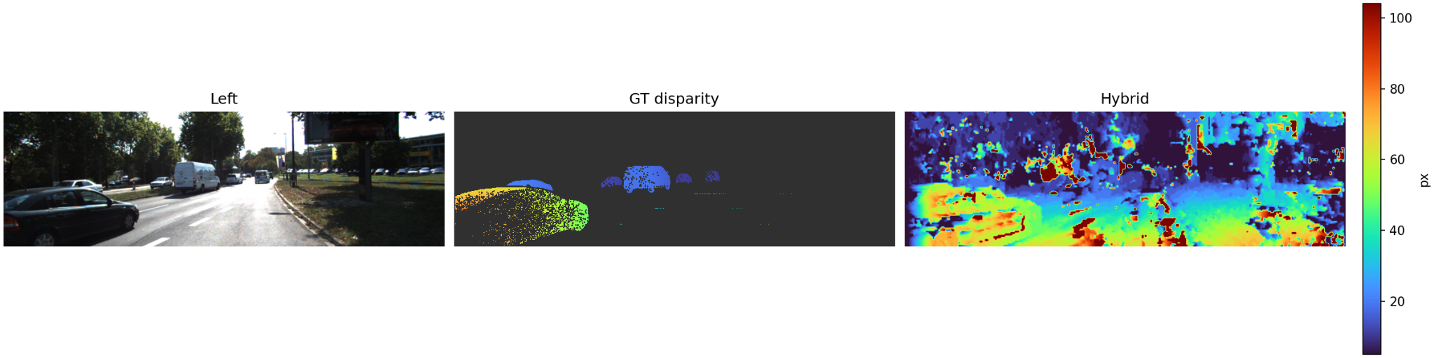
Hybrid Method
Concept: Exploit the deterministic stereo geometry of classical methods while using a lightweight neural network for refinement
Initial Disparity Proposal with SGM
Learned Refinement
Final Disparity and depth

Slide 6
Deep Learning Models

Slide 7
HITNet

Slide 8
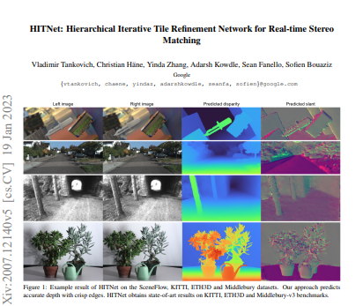
What is HITNet?
Proposed by Google Research (Tankovich et al., 2023)
Designed for fast and accurate stereo matching
Works without building full 3D cost volumes
Uses tiled disparity hypotheses and iterative refinement
Modular design; supports different encoders
Suitable for real-time or resource-limited systems
KITTI for evaluation, we use it for training

Slide 9
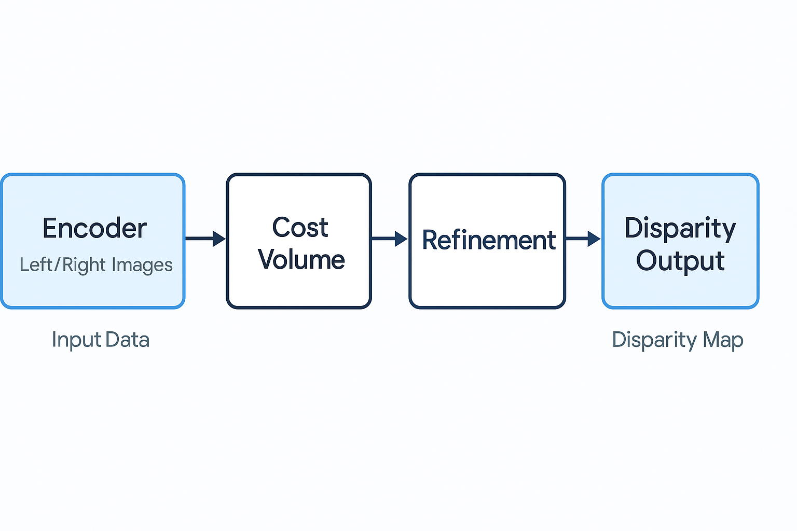
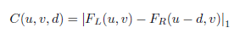
HITNet Architecture
Encoder extracts features from stereo inputs (L & R)
Cost volume computed as
Hierarchical iterative tile refinement
Final disparity obtained by soft-argmin + bilinear upsampling

Slide 10
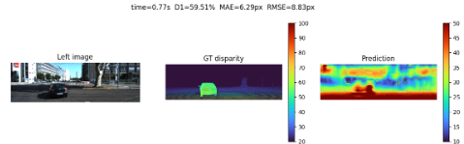
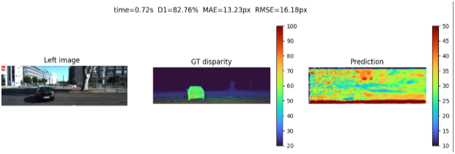
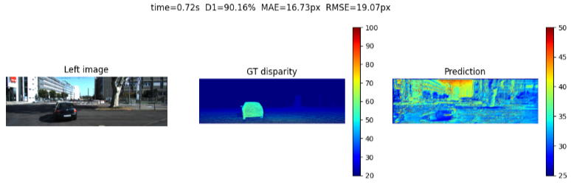
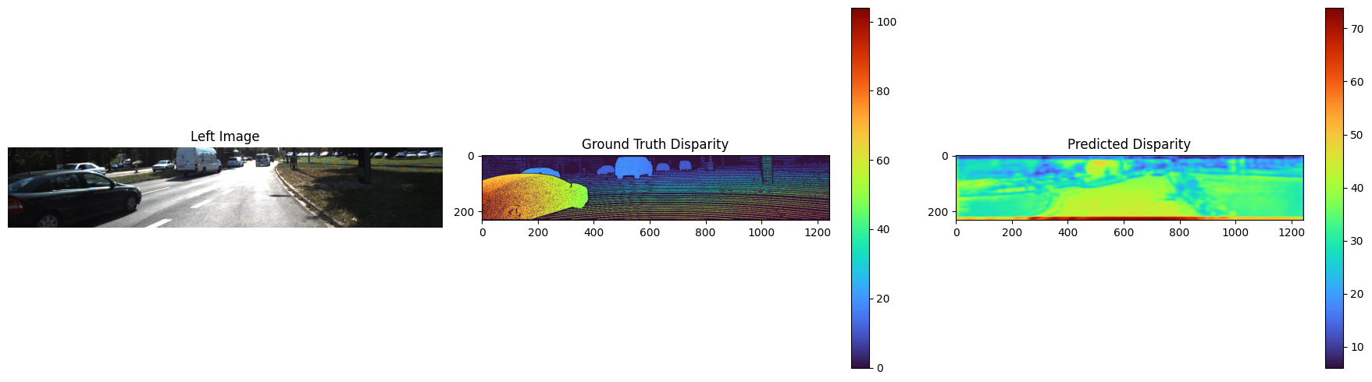
U-Net
HITNet Variant Results
MobileNet
Custom Lite
HITNetV2
U-Net
Accurate, strong boundary preservation
High runtime
MobileNetV2
Fast, compact; less accurate
Custom Lite CNN
Smallest model size, fastest; sacrifices edge detail
HITNet V2
Custom CNN + cropped KITTI inputs
Better focus on valid depth regions

Slide 11
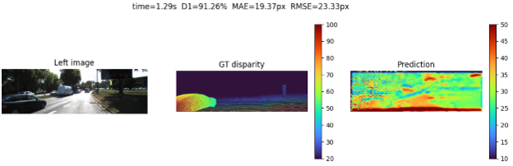
HITNet vs. HITNetV2
HITNet
HITNetV2
HITNet (top): struggles with sky/occluded areas → noisy predictions
HITNetV2 (bottom): crops out invalid regions → cleaner, more structured output
MAE & RMSE improve significantly despite smaller encoder
Inference time slightly increases due to added refinement steps

Slide 12
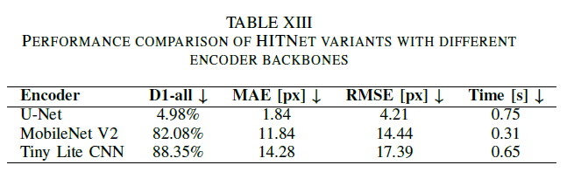
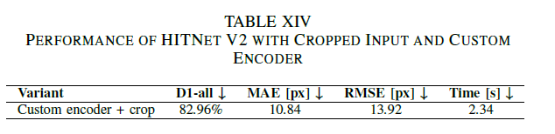
HITNet Variant Results - Quantitative

Slide 13
Thus..
U-Net + HITNet → best performance
Custom CNN good for edge devices
Cropping invalid top rows (HITNet V2) improves stability a bit
Future work may include:
Add confidence-aware cost volumes
Feature-level object awareness (FiLM / attention)
Scene flow supervision from synthetic datasets

Slide 14
StereoNet

Slide 15
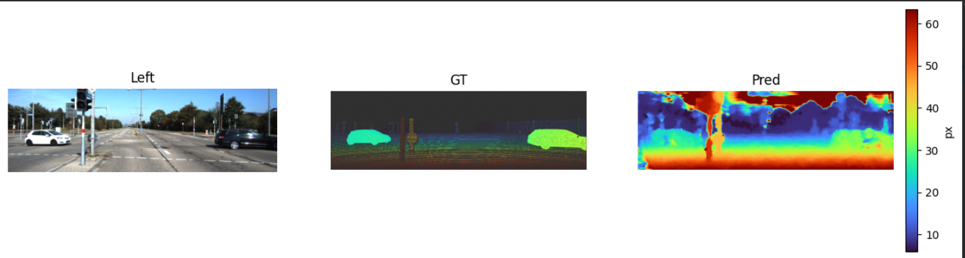
Why StereoNet?
Single-shot soft-argmin → fast, memory-light
Accuracy governed almost entirely by 2-D feature extractor
Ideal sandbox to test encoder capacity vs. runtime

Slide 16
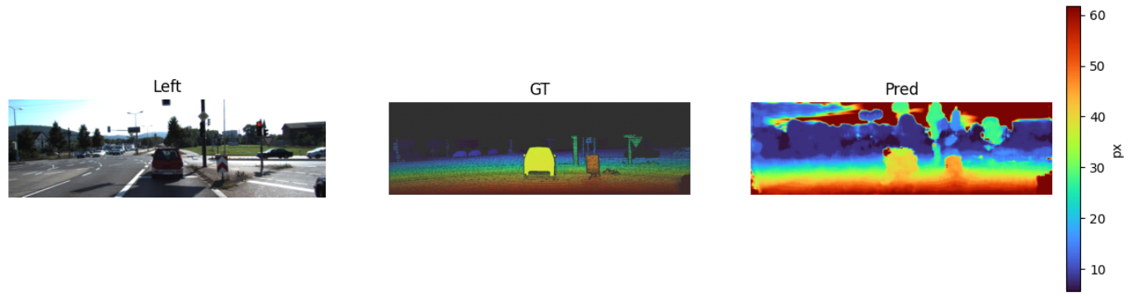
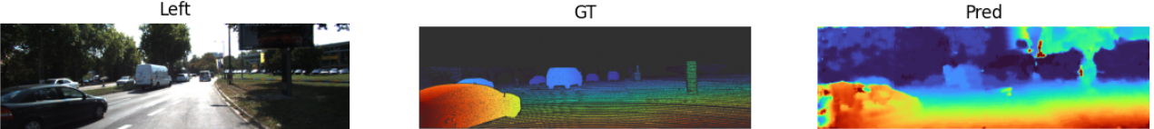
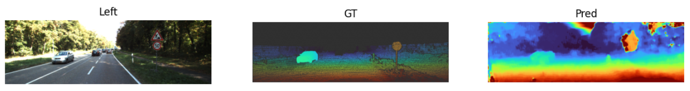

Slide 17
Feature extractor we tested
Feature Extractors | capacity | comment
Tiny-CNN (our custom one) | 0.1 M params | 4 × Conv-BN-ReLU, our lightweight baseline
U-Net encoder | 1.3 M | two down-sampling stages, no decoder
ResNet-18 (trunc.) | 2.7 M | conv1 + conv2_x, stride = 4
ResNet-18 + mask | 2.7 M | same as above, 4-ch input (RGB + object mask)

Slide 18
Quantitative results (KITTI-val, ↓ better)
backbone | D1-all [%] | MAE [px] | RMSE [px] | time [s/pair]
Tiny-CNN | 12.53 | 2.82 | 9.57 | 0.13
U-Net enc. | 12.50 | 2.80 | 9.60 | 0.17
ResNet-18 | 17.27 | 2.86 | 8.16 | 0.13
ResNet-18 + mask | 58.90 | 5.59 | 8.51 | 0.20

Slide 19
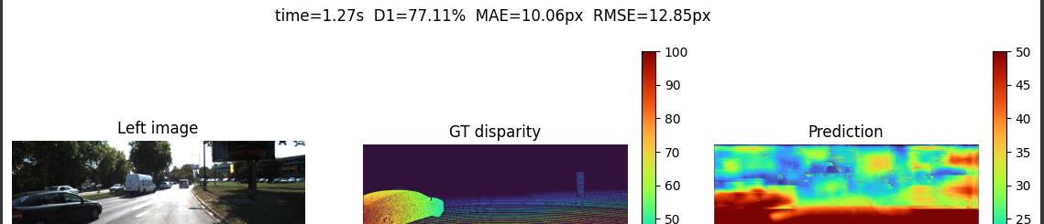
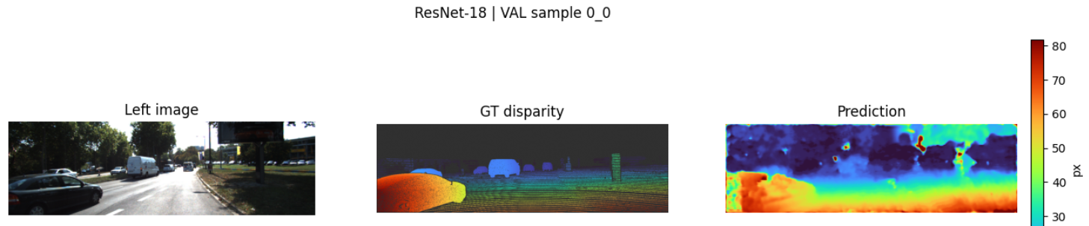
ResNet-18 delivers the best overall accuracy with only +20 ms latency.
U-Net adds depth but without its decoder gains little over the tiny baseline.
Naïvely injecting an object mask improves MAE/RMSE but hurts D1-all: network over-fits to mask borders, neglecting background. (First one is hitnet second one is with steronet)

Slide 20
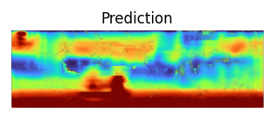
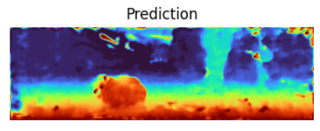
HITNet (U-Net) vs StereoNet (ResNet-18)
model family | Feature extractot | D1-all [%] ↓ | MAE [px] ↓ | RMSE [px] ↓ | time [s/pair] ↓
HITNet | U-Net (full encoder + iterative refinement) | 4.98 | 1.84 | 4.21 | 0.75
StereoNet | ResNet-18 (trunc., single soft-argmin) | 17.27 | 2.86 | 8.16 | 0.13

